Slide 1
Digital Portfolio 2025
Name: THARANGINI
Register No: 20624U18109 and 7C847273E876E69AB984DF032057A7B5
Department: BSC [Computer science]
College: [KAMBAN COLLEGE OF ARTS AND SCIENCE FOR WOMEN/THIRUVALLUVAR UNIVERSITY]

Slide 2
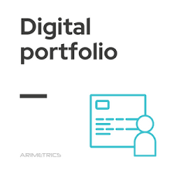
PROJECT TITLE
DIGITAL PORTFOLIO

Slide 3
DEFINITION OF DIGITAL PORTFOLIO
A digital portfolio is an online collection of an individual's work, skills, and accomplishments.
It serves as a dynamic and visually engaging platform to showcase professional capabilities and experiences to potential employers, clients, or collaborators.
Unlike traditional paper-based portfolios, digital portfolios can easily incorporate multimedia elements like images, videos, and interactive content, making them a powerful tool for demonstrating expertise

Slide 4
Agenda
Problem Statement
Project Overview
End Users
Tools and Technologies
Portfolio design and Layout
Features and Functionality
Results and Screenshots
Conclusion
Github Link

Slide 5

PROBLEM STATEMENT
In today's digital age, individuals—especially students, professionals, and creatives—face challenges in showcasing their skills, achievements, and personal brand effectively.
Traditional resumes and paper-based portfolios lack interactivity, accessibility, and the ability to reflect a person's dynamic capabilities in real time.
Employers, clients, and academic institutions increasingly expect a more comprehensive, visually appealing, and interactive way to evaluate a candidate’s work and qualifications.

Slide 6
PROJECT OVERVIEW
Project description
Purpose and goals
Key features
Target users
Technologies used (Example)

Slide 7
Project Description
This project involves the design and development of a digital portfolio website that serves as an interactive platform for individuals to present their skills, projects, experiences, education, and achievements in a visually appealing and organized manner. The digital portfolio is intended to enhance personal branding and make it easier for employers, clients, or academic institutions to assess the individual's qualifications and work.
The website will be fully responsive, ensuring optimal viewing on desktops, tablets, and smartphones. It will also support multimedia elements such as images, videos, and downloadable files to provide a dynamic and engaging experience.

Slide 8
Purpose and Goals
To create a professional online presence.
To provide a centralized platform for showcasing skills, projects, certifications, and experiences.
To enable easy sharing of personal or professional information via a web link.
To help users stand out in job applications, freelance markets, or academic opportunities.

Slide 9
Key features
About Me section
Resume/CV download option
Skills & Tools listing
Project Showcase with descriptions, images, and links
Education and Experience timelines
Contact Form or integrated contact details
Responsive Design (mobile-friendly)
Customizable Theme (optional)

Slide 10
Target Users
Students and recent graduates
Job seekers and professionals
Freelancers and creatives (designers, developers, writers, etc.)
Academics and researchers

Slide 11
Technologies Used (Example)
Frontend: HTML, CSS, JavaScript (or React.js, depending on the scope)
Backend (optional): Node.js, Firebase, or PHP
Design Tools: Figma, Adobe XD (for UI/UX design)
Hosting: GitHub Pages, Netlify, or personal domain

Slide 12
End Users
1.Students
Use the digital portfolio to showcase academic achievements, coursework, personal projects, and extracurricular activities.
Helpful when applying for internships, scholarships, or higher education.
2.Freelancers & Creatives
Designers, writers, photographers, and developers can display their portfolios to attract clients.
Helps in building credibility and attracting freelance or contract work.
3. Educators & Researchers
Showcase publications, research work, conferences, and academic contributions.
Useful for academic visibility and collaboration opportunities.

Slide 13
Tools & Technologies
Front-End Technologies (For Design & UI Development):
These tools help build the structure, style, and interactivity of your portfolio.
HTML5 – For structuring the content of the web pages.
CSS3 / SCSS – For styling and layout (colors, fonts, animations).
JavaScript – For adding interactivity (e.g., animations, sliders).
Bootstrap / Tailwind CSS – CSS frameworks for faster responsive design.

Slide 14

Portfolio Design

Slide 15

Portfolio Layout

Slide 16
Features and Functionality
Responsive Design
Function: Automatically adjusts to different screen sizes (desktop, tablet, mobile).
Benefit: Enhances usability and accessibility across all devices.
✅ 2. Interactive Navigation
Function: Smooth scrolling, sticky navbars, and menu links.
Benefit: Easy access to different sections of the portfolio.
✅ 3. Dynamic Project Showcase
Function: Projects displayed in cards, modals, or sliders with images, links, and descriptions.
Benefit: Lets visitors easily explore your work with visuals and context.
✅ 4. Contact Form Integration
Function: Simple contact form with name, email, and message fields.
Tools: EmailJS, Formspree, or backend script.
Benefit: Enables potential employers or clients to get in touch.
✅ 5. Downloadable Resume
Function: Button or link to download your CV in PDF format.
Benefit: Allows easy sharing of your qualifications offline.

Slide 17
Result
  Portfolio website successfully developed and deployed.
  Showcases Home,About,Projects, and Contact sections.
  Fully responsive design (works on mobile,tablet, desktop)
  Enhances professional visibility for job & internship opportunities

Slide 18
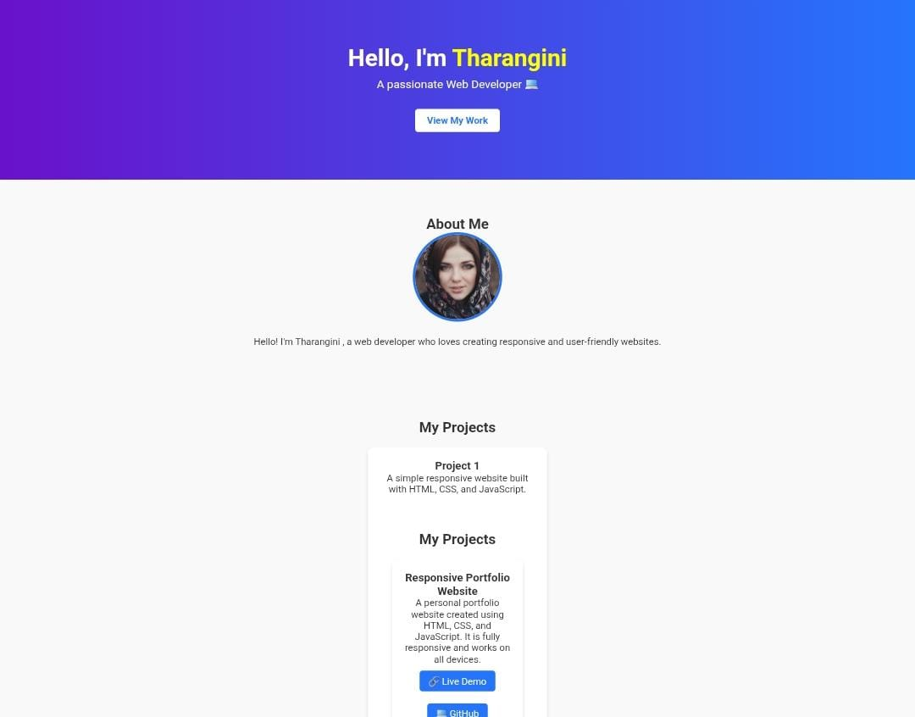
Screenshots

Slide 19
Conclusion
Learned front-end web development. Portfolio acts as a living resume.

Slide 20
Links & References
CodePen: https://codepen.io/-the-looper/pen/ByoVWVo
GitHub: [Your GitHub Link]

